Slide 1
DEVELOPING AN AUTOMATED DEPLOYMENT SYSTEM FOR CLOUD INFRASTRUCTURE PROVISIONING AND APPLICATION DEPLOYMENT
MINISTRY OF EDUCATION AND TRAINING CAN THO UNIVERSITY COLLEGE OF INFORMATION AND COMMUNICATION TECHNOLOGY
GRADUATION THESIS BACHELOR OF ENGINEERING IN INFORMATION TECHNOLOGY (HIGH-QUALITY PROGRAM)
Advisor: Dr. Thai Minh Tuan
Student: Truong Dang Truc Lam
Student ID: B2111933

Slide 2
AGENDA
Problem statement
Related work
Objectives
Research scope
Solution implementation
Conclusion and future work

Slide 3
PROBLEM STATEMENT
Cloud adoption rising across many enterprises.
Manual processes still widely in use.
Increases risk of misconfiguration and errors.
Inconsistencies across development to production.
Slows down CI/CD and collaboration.
Conflicts with modern DevOps principles.

Slide 4
RELATED WORK
Automation helps reduce errors and effort.
IaC improves consistency but lacks flexibility.
Limited handling of dynamic resource demands.
CI/CD integration with cloud remains complex.
Failure recovery often needs manual steps.
Real environments not fully addressed.

Slide 5
OBJECTIVES
Automate cloud infrastructure provisioning process.
Automate remote configuration of cloud instances.
Apply containerization for application portability.
Minimize downtime with safe deployment strategies.
Enhance security for both infrastructure and application.
Integrate all steps into CI/CD pipeline.

Slide 6







RESEARCH SCOPE
Cloud computing
IaC
CI/CD
AWS - Free Tier
Terraform
Ansible
GitHub Actions
Containerization
Application security
Deployment strategy
Docker
Web application security
Blue-Green

Slide 7
SOLUTION IMPLEMENTATION

Slide 8
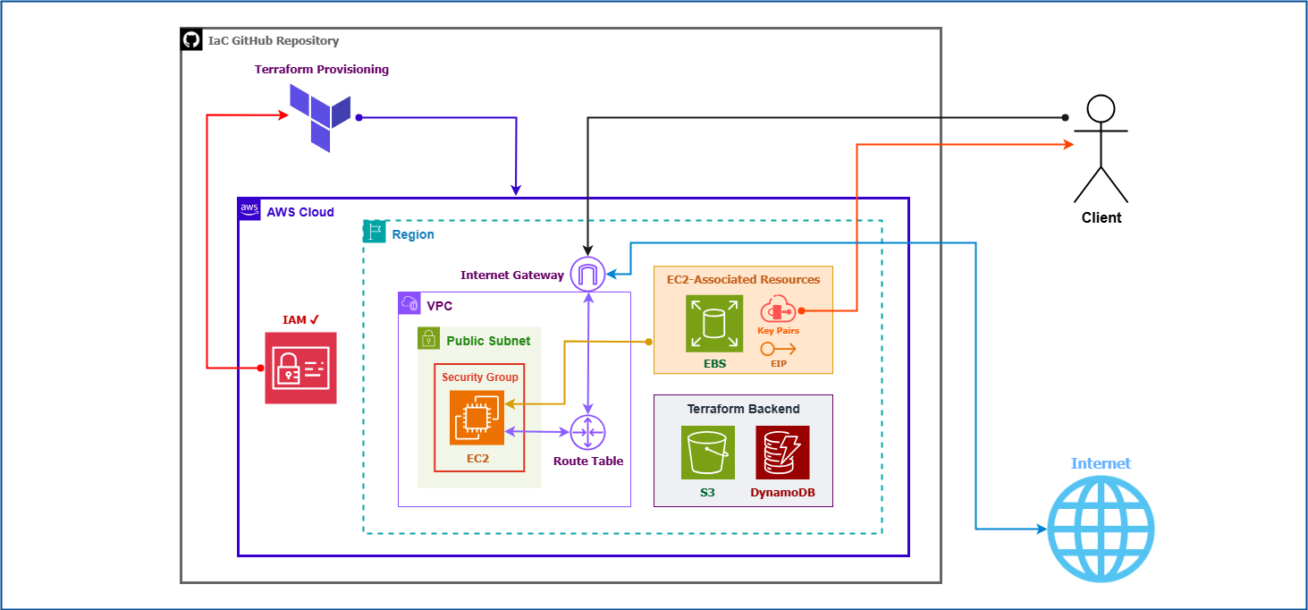

Slide 9
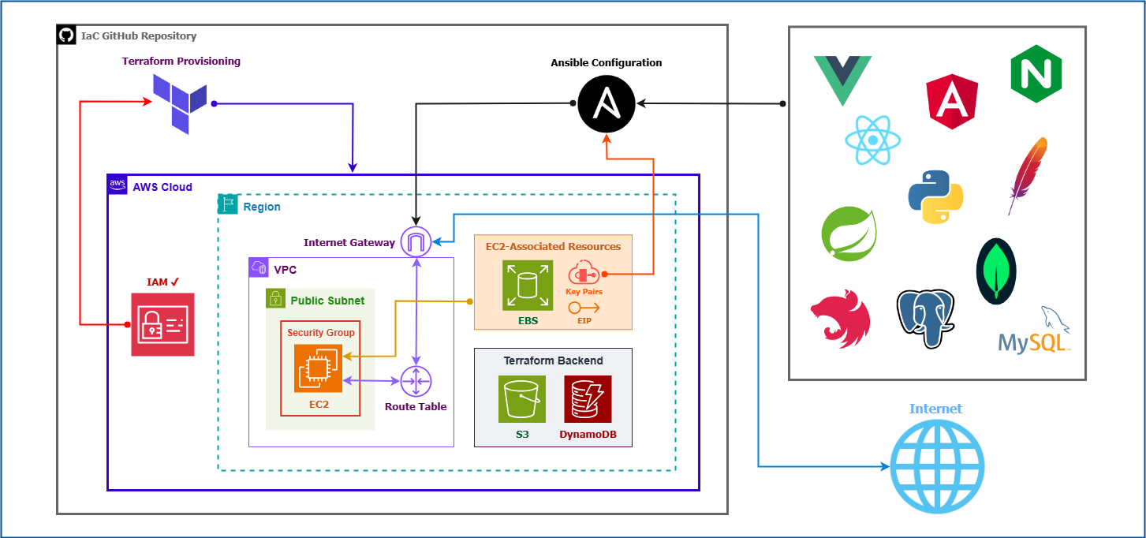

Slide 10
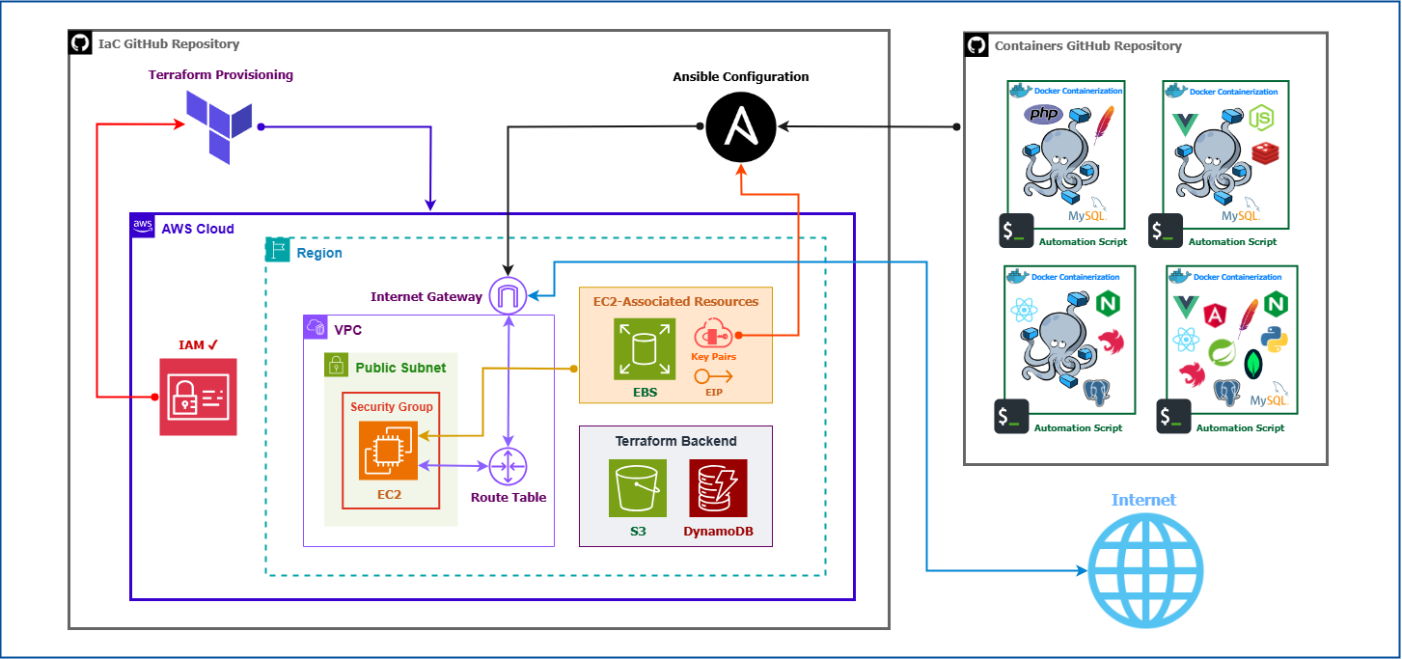

Slide 11
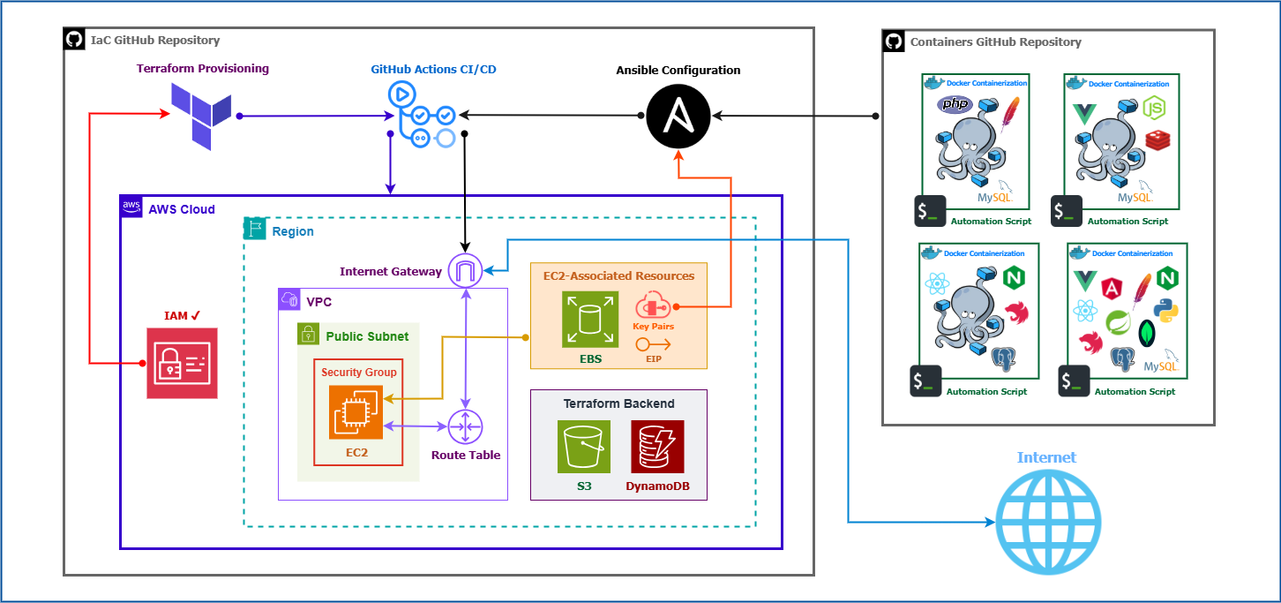

Slide 12
CONCLUSION AND FUTURE WORK
Conclusion
Demonstrated full automation from provisioning to deployment.
Ensured consistency, scalability and security.
Operated reliably even under AWS Free Tier constraints.
Future work
Expand with CDN and AWS-native components.
Explore hybrid or multi-cloud deployments.
Integrate compliance checks and AI-based scaling.

Slide 13
THANK YOU VERY MUCH
Can Tho University

